Slide 1
Wordpress - beginner
Trish Conner-Cato

Slide 2
Module 1: introducing wordpress
Understanding the Common Terms
Lesson 3
Getting to know the WordPress family
Lesson 2
Lesson 4
Digging into WordPress – the features
Lesson 1
Why choose WordPress?
Lesson 5
Learning more with online WordPress resources

Slide 3
Module 1: introducing wordpress
Lesson 6
Staying updated with WordPress news
Lesson 8
Getting support from other users
Understanding the Codex
Lesson 7
Lesson 9
Using theme and plugin directories

Slide 4
lesson 1: understanding the common terms
Click here to view common terms and their definitions

Slide 5
lesson 2: why choose wordPress?
WordPress is free and can be used to create any type of website. The software itself is free, you do need a domain name and web hosting to install it.
WordPress is easy to use
WordPress is completely customizable
WordPress is SEO friendly
WordPress is safe and secure
WordPress is here to stay – that’s because it’s open-source software (not maintained by one person or company).

Slide 6
lesson 3: getting to know the wordpress family
Family Role | Responsibilities
Head of Household | This role is occupied by the WordPress Core. While the core of functionality has remained relatively unchanged (with the exception of the new editor), there is one part that is continuously being updated: security.
The Spouse | The spouse represents the theme you use in WordPress. Like any relationship, compatibility is a large factor in the success of the union. A theme controls the visual elements of your site, what layout you can use, and core parts of how your site can function as well.
The Children | WordPress core by itself does not have much functionality. A massive number of plugins can cover almost any functionality you are looking for. Plugins are like children; they need to be watched to make sure they don’t misbehave, and they don’t always play well with one another.

Slide 7
lesson 4: digging into wordpress – the features
Exchangeable designs through themes
Extendable through plugins
Unlimited posts and pages, categories and subcategories, and tags
Responsive design
Flexible – supports multiple types of websites
Scalable – can handle any size of website
Ability to post via email and mobile devices
Compliance with the World Wide Web Consortium (W3C) standards, depending on the theme you’re using
Import of data from other blogs
Easy to administer and blog without any experience

Slide 8
lesson 4: digging into wordpress – the features
Convenient, fully functional, built-in search
Multilingual with good internationalization
Secure code
Ability to password-protect content
Comments manager and spam protection
Built-in workflow (write, draft, review, and publish)
Intelligent text and content editing via a visual editor
Multiuser and multiauthor support for user accounts
Feature-rich media library for managing photos and other non-text content
Social media integration capabilities

Slide 9
lesson 4: digging into wordpress – the features
Dynamic and scalable revision functionality
Built-in embed functionality through shortcodes
Compatible with services such as YouTube, Vimeo, Flickr, SoundCloud, and others
An admin panel that’s accessible via all modern devices, operating systems, and browsers
Full accessibility for front end elements of the website
User-friendly image editing, plus a drag-and-drop image importing feature
Advanced SEO features through plugins and themes
Integrated REST API infrastructure
An interface that two computer systems use to exchange information securely over the internet.

Slide 10
Lessons 5-8: useful links
Click here to view useful links

Slide 11
Lesson 9: using theme and plugin directories
WordPress stores theme files in:
/wp-content/themes/folder
WordPress stores plugin files in:
/wp-content/plugins
These directories are stored on your web hosting server. Most WordPress hosting control panels allow access to File Manager.

Slide 12
Module 2: getting started with wordpress
Getting and installing WordPress
Lesson 3
Installing WordPress through an auto-installer script
Lesson 4
The wp-admin panel
Lesson 1
Lesson 5
Getting a Gravatar
Lesson 2
The two worlds of WordPress – the difference between WordPress.com and WordPress.org

Slide 13
Lesson 1: wordpress.com vs. wordpress.org
Both are backed by the same people. There’s a ton of collaboration between the two communities. They each cater to a different market segment. They each have their own personality, community, and culture.
WordPress.com provides hosting and a platform in which to build your site, using WordPress software.
WordPress.org does not provide hosting and it’s not even a platform, as it’s often referred to. It is a website hub that houses information, downloads, resources , and a community.

Slide 14
Lesson 2: getting and installing wordpress
As mentioned earlier, you need both web hosting and a domain name to use WordPress.
There are a host of web hosting providers to choose from. The one I am using is Bluehost. It is officially recommended by WordPress.org and has an easy to use dashboard.
Click here to see a list of hosting providers: 10+ Best WordPress Hosting Companies of March 2023 (themeisle.com)
Click here if you want to use Bluehost: Best Web Hosting - Domains - WordPress - 2022 | Bluehost.com
The following instructions are based on selecting Bluehost as the web hosting provider.

Slide 15
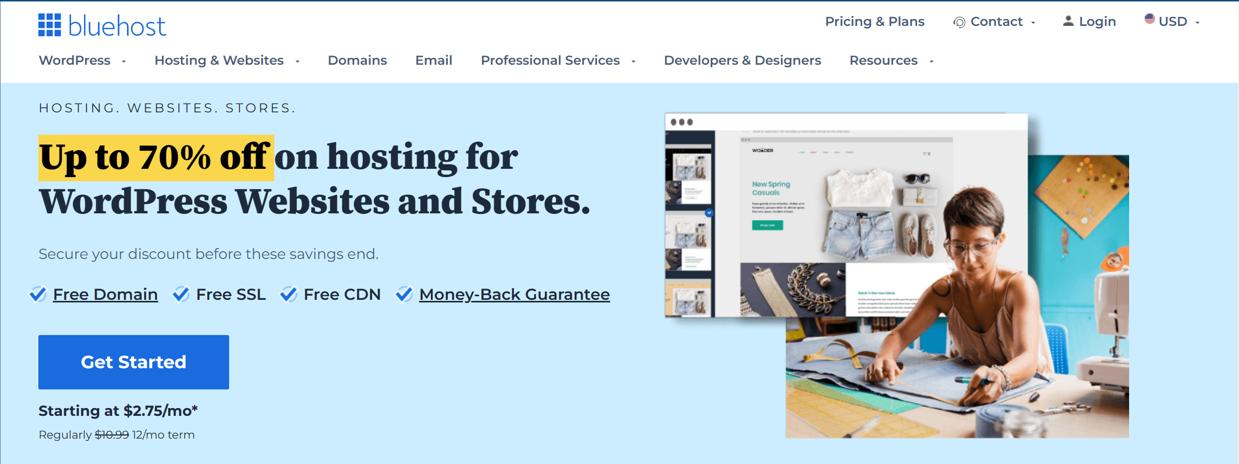
Lesson 2: getting and installing wordpress

Slide 16
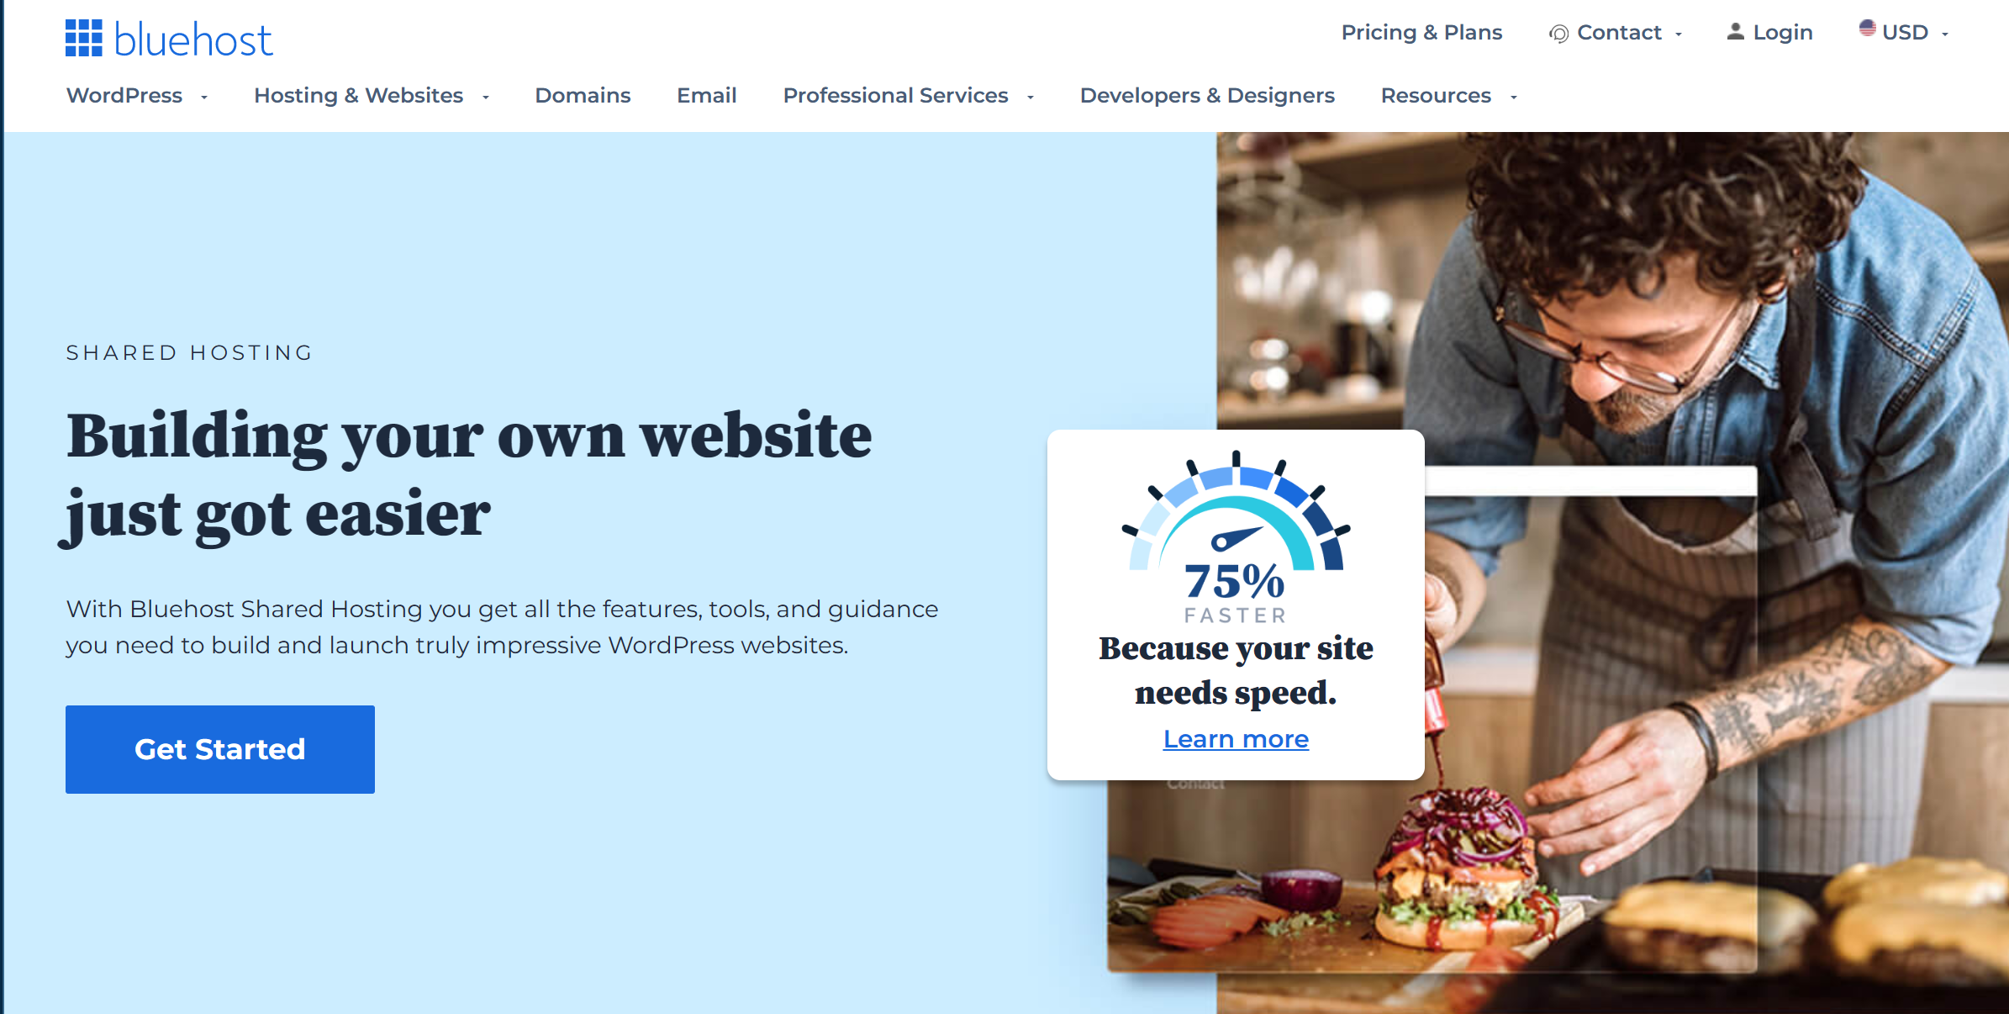
Lesson 2: getting and installing wordpress

Slide 17
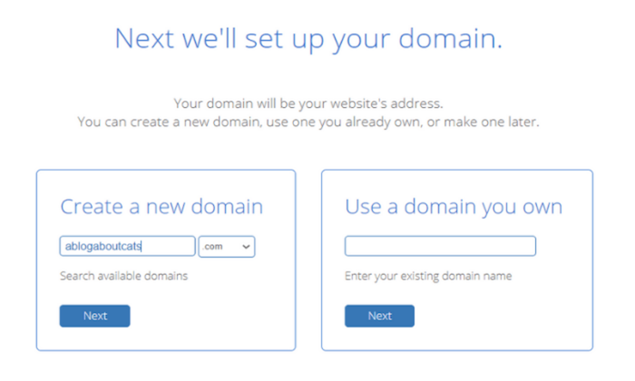
Lesson 2: getting and installing wordpress
The next screen will show your plan choices:
Shared Web Hosting Plans - Fast & Secure Shared Hosting | Bluehost.com
Then you will address your domain:

Slide 18
Lesson 2: getting and installing wordpress
After you complete your domain information, you will be filling out your personal information to create your account on the website. You can also sign in with Google to speed up the process.
Next, you have to confirm your plan details. Bluehost has several premium add-ons by default, so make sure you go through them carefully and remove ones you don’t need. These include:
Domain Privacy + Protection (starting from $11.88 a year)
SiteLock Security Essentials (starting from $23.88 a year)
CodeGuard Basic (starting from $2.99 a year)
Bluehost SEO Tools (starting from $23.88 $ a year)

Slide 19
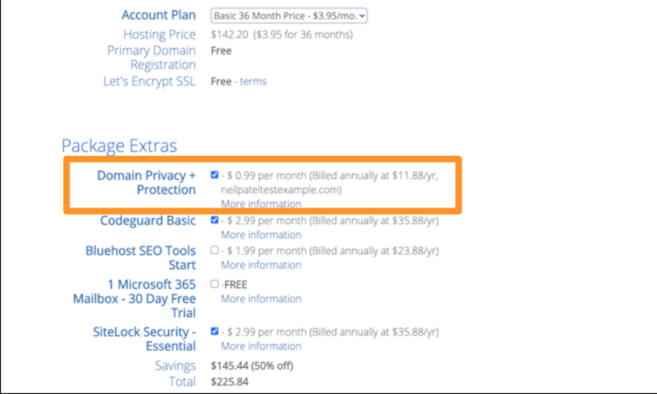
Lesson 2: getting and installing wordpress

Slide 20
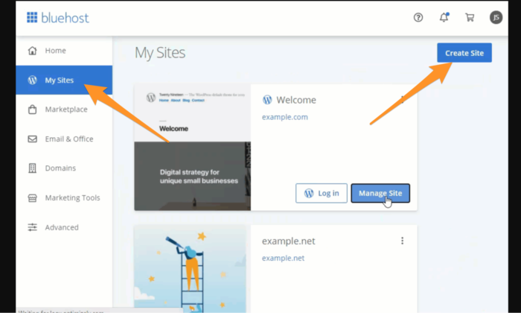
Lesson 2: getting and installing wordpress
You will be prompted for a phone number and email address to send your receipt to. And, you have the option of choosing the number of years you want the plan for. After confirming your plan choices, you will be able to enter your payment information and process the transaction. After logging into Bluehost, you will select My Sites and then Create Site:

Slide 21
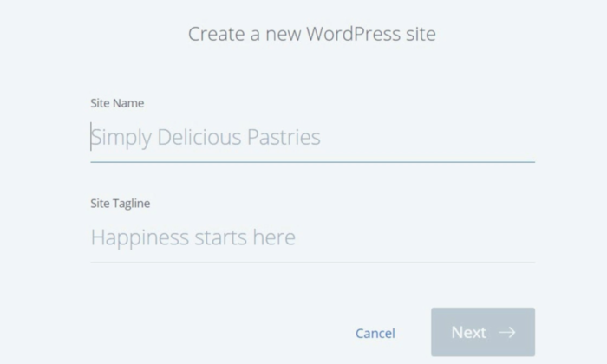
Lesson 2: getting and installing wordpress
Fill in your site name and site tagline – which can be changed later.

Slide 22
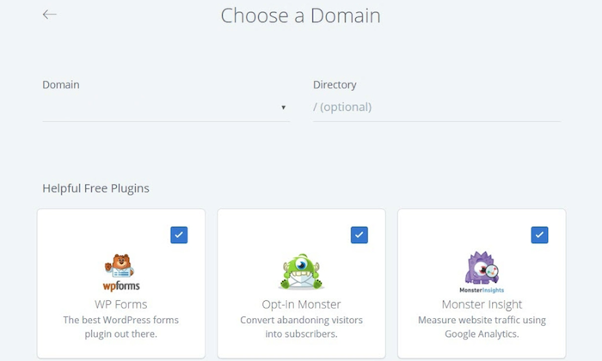
Lesson 2: getting and installing wordpress
Before WordPress installation, you’ll have to choose your domain name. In the Choose a Domain field, select the domain name you decided previously when creating your account.
Once you click on Next, Bluehost will start installing WordPress for you.

Slide 23
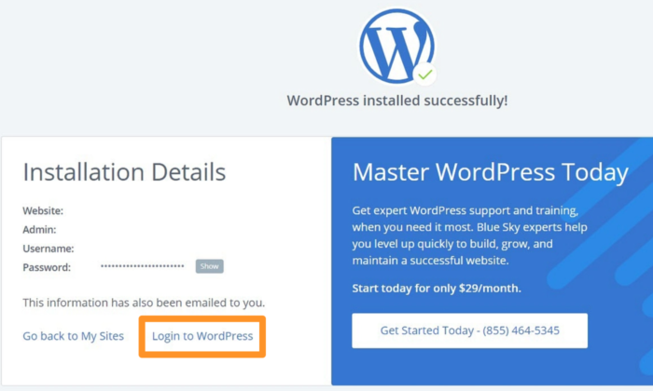
Lesson 2: getting and installing wordpress
You’ll automatically get your brand-new WordPress website, along with login credentials. Want to open your new WordPress website? Click on the Login to WordPress link.

Slide 24
Lesson 5: getting a gravatar
WordPress uses a specific type of avatar called gravatars – short for Globally Recognized Avatar.
Unlike standard avatars, Gravatars follow you around the web and automatically appear when you post a comment on a WordPress site.
Once registered with Gravatar, the service matches your WordPress profile information to the email address registered with Gravatar and displays your custom Gravatar image next to comments and (optionally) elsewhere on the WordPress site.
If you choose not to sign up with Gravatar, the default icon set by the Administrator appears next to your name.

Slide 25
Lesson 5: user roles (capabilities) in wordpress
Role | Capabilities
SEO Editor | Editor can access only the SEO content box in posts and pages and other areas where they might need to adjust.
SEO Manager | Manager has ability to edit the Yoast SEO settings and metadata information.
Subscriber | Least amount of permissions – the only part of a site that a subscriber can modify is their profile page.
Contributor | Can write posts, but has no control over publication. Once written, the post will be submitted for proofreading by a user with more rights, who will decide whether or not it can be published. Contributor can add categories and tags via the post editing interface. Contributor will not be able to modify the post online and can only read comments under the posts but cannot moderate them.
Author | Can publish posts, send files and add images. Author can also modify and delete their own publications. Author can moderate comments on their articles. Author cannot intervene on the publications of other users.
Editor | Control over all editorial matters. Editor can publish pages and also edit and delete them, even if created by other users. Editor can add, modify, and delete categories and tags. Editor can completely manage comments, and validate, moderate and delete them.
Administrator | Can do everything on your site.

Slide 26
Module 3: creating blog content
Lesson 1
WordPress admin conventions
Lesson 3
Posting on your blog
Lesson 5
Adding and managing categories
Discussion on your blog - comments
Lesson 4
Lesson 2
Building your WordPress website

Slide 27
Lesson 1: wordpress admin conventions
In wp-admin, you have the ability to manage a number of different types of content and content sorting types, including posts, categories, pages, links, media uploads, and more. WordPress uses a similar format for various screens.
For every piece of content in WordPress that you might want to manage, there will be a screen listing them.

Slide 28
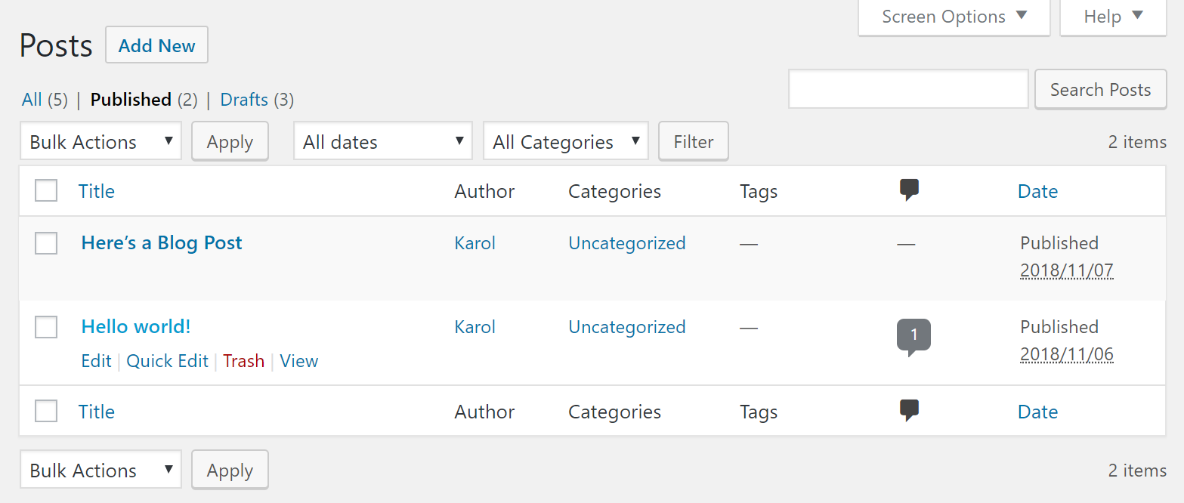
Lesson 1: wordpress admin conventions

Slide 29
Lesson 3: blog post formats
Format | Description
Standard | Uses your theme’s built-in post layout without customization. Can also add other elements like images and videos to your post.
Gallery | Adds images to your post in a gallery style. You can show multiple photos in your post at once.
Image | Adds a single image to your posts.
Aside | Allows you to add a quick note, like a reference link.
Link | Adds links to other websites.
Video | Attaches a single video or a playlist from third-party websites, like YouTube and Vimeo. You can have the media embedded in your post or accessed via a URL.
Audio | Uploads an audio file or playlist from third-party services. Supports various types, including music and podcast.
Quote | Shares a quote you want to highlight on your blog page.
Status | Creates a simple one-line status update with no entry title, similar to a status post on Twitter.
Chat | The post will display as a chat transcript.

Slide 30
Lesson 5: categories vs. tags
Categories and tags are two primary ways to group content on a WordPress site. Both are used in conjunction with SEO.
Categories are general labels – it is recommended that you use no more than 2-3 categories per post (Vegetables, Herbs, Fruits).
Tags are more specific and indicate the individual things the post talks about. You are expected to use multiple tags per post (garden, gardening, cherry-tomatoes, tomatoes, plants).
Our focus will be on categories in this course.

Slide 31
Module 4: pages, media, and importing/exporting content
Lesson 1
Pages
Lesson 2
Media library
Lesson 3
Importing/Exporting Content

Slide 32
Lesson 2: media library – file types
Images (.jpg, .jpeg, .png,.gif, and .ico)
Audio (.mp3, .m4a, .ogg, and .wav)
Videos (.mp4, .m4v, .mov, .wmv, .avi, .mpg, .ogv, .3gp, and .3g2)
PDFs and Adobe Photoshop documents
Word documents, Excel spreadsheets, PowerPoint presentations
Visit Openly Licensed Images, Audio and More | Openverse for an extensive library of free stock photos, images, and audio.

Slide 33
Lesson 3: importing / exporting content
You may want to import/export content into your WordPress site.
For example, you may want to move your site from WordPress.com to WordPress.org (or vice versa). Or, you might want to move content from another platform into WordPress. Or, you might be rebuilding your site and you want to move key content to a clean install of WordPress.

Slide 34
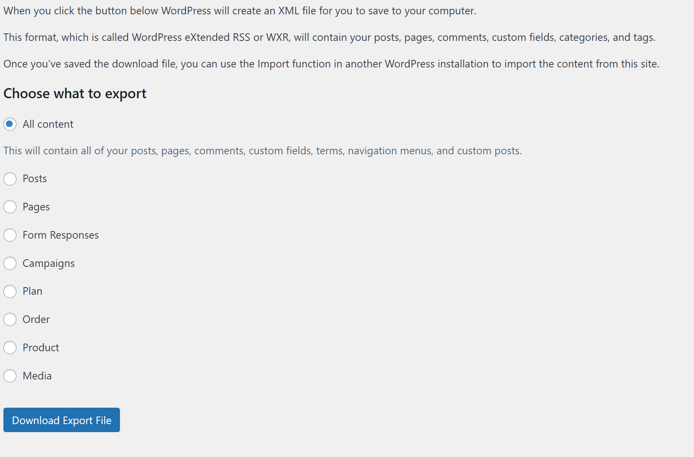
Lesson 3: Exporting content
WordPress Export | WordPress.com Support

Slide 35
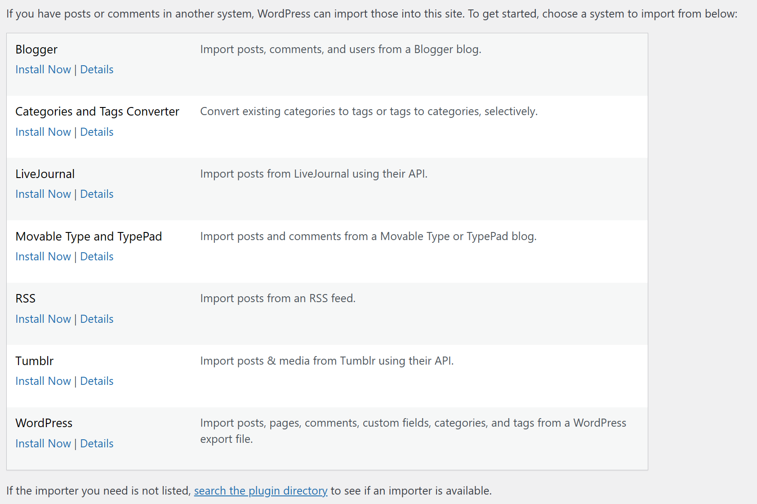
Lesson 3: importing content
Importing Content – WordPress.org Documentation

Slide 36
Module 5: plugins – what they are and why you need them
Lesson 1
Breaking down plugins – what are they?
Lesson 2
Installing plugins – how to go about this
The must-have pack of plugins
Lesson 3

Slide 37
lesson 1: breaking down plugins – what ARE they?
As mentioned earlier, plugins are the children of the WordPress family. Also mentioned is the fact that the WordPress core does not have much functionality. Plugins allow you to add new functionality or extend existing functionality on your site, allowing you to create virtually any kind of website, from e-commerce stores to portfolios to directory sites. Plugins literally “plug into” your WordPress site.

Slide 38
lesson 3: The must have pack of plugins
Click here to view recommended plugins

